Slide 1
Paper Id: 2422
Paper Title: Real-Time Distress Recognition and Alert Generation Using Multi-Sensor Wearable Devices
Author Name: Roshan L, Tamilarasi Rajamani, Dr. Manish Bhardwaj, Sridhar D, Thejashri S, Navya S
Designation: Student
Affiliation: Alliance University | PMC Tech
Track No.: 4
Session No.:17

Slide 2
Table of Contents
Introduction
Problem Statement & Research Gap
Proposed System
System Architecture
Technologies Used
Methodology (System Workflow)
Methodology (AI Model & Alert System)
Experimental Results
Results & Discussion
Conclusion
References

Slide 3
Introduction
Road accidents caused by driver fatigue and sudden medical emergencies remain a major global concern.
In many cases, drivers are unable to respond or seek help during critical conditions.
Existing solutions (camera-based / internet-dependent) fail in low-light and low-connectivity environments.
Lack of continuous physiological monitoring leads to delayed detection of distress.
There is a need for a reliable, real-time, and autonomous safety system.

Slide 4
Problem Statement & Research Gap
Driver fatigue and medical emergencies (e.g., hypoxia, cardiac events) can incapacitate drivers without warning.
Manual intervention is often impossible, causing critical delays in emergency response.
Camera-based systems are unreliable in low light and cannot detect internal physiological changes.
Internet-dependent solutions fail in tunnels, rural areas, or poor connectivity conditions.
Existing systems typically use single-sensor inputs, leading to lower detection accuracy.

Slide 5
Proposed System
AI-powered wearable smartwatch for real-time distress detection
Multi-sensor fusion: ECG, Heart Rate (HR), SpO₂, motion (IMU)
On-device AI (TinyML) using a lightweight 1D-CNN on ESP32-S3
Fully offline operation — no internet dependency
Autonomous emergency alerting via GSM with GPS location + vital signs
Manual override: SOS button / voice trigger; 10-minute audio buffer for context

Slide 6
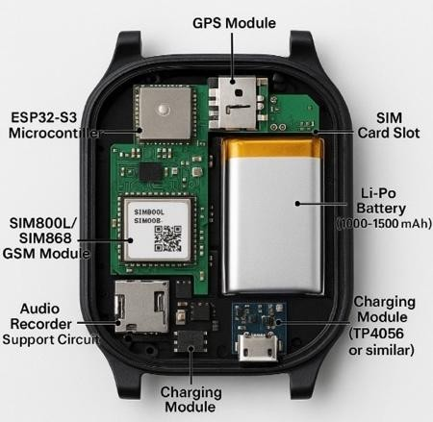
System Architecture
Sensor Layer:
ECG, Heart Rate (HR), SpO₂, Motion (IMU) collect real-time physiological & movement data
Processing Layer:
ESP32-S3 processes data and runs TinyML (1D-CNN model)
Decision Layer:
Classifies user state → Alert / Drowsy / Crash
Alert Layer:
GSM module (SIM800L) sends SMS with GPS location + health data

Slide 7
Technologies Used
ESP32-S3 Microcontroller — central processing unit; runs firmware and on-device AI inference
TinyML (Tiny Machine Learning) — enables offline AI execution on embedded hardware
TensorFlow Lite (TFLite Micro) — deploys the trained 1D-CNN model in a lightweight format
1D-CNN (Convolutional Neural Network) — analyzes time-series signals (ECG, HR, SpO₂, motion) for state classification
Sensors: MAX86150 (ECG, HR, SpO₂), BNO055 (IMU) — real-time physiological & motion data acquisition
Communication: GSM (SIM800L) for SMS alerts; GPS for location tracking; BLE for low-power interfacing

Slide 8
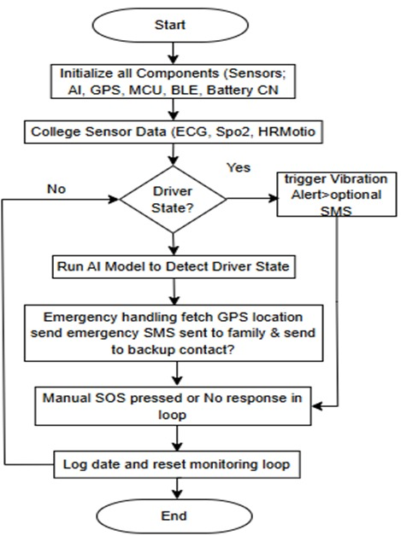
Methodology – System Workflow

Slide 9
Methodology – System Workflow
Feature Extraction
Heart Rate (HR) and Heart Rate Variability (HRV)
Blood Oxygen Level (SpO₂)
Acceleration patterns (motion/impact detection)
Condition Monitoring
HR < 50 or > 130 BPM
SpO₂ < 90%
Sudden acceleration (> ±3g)
AI Trigger
Processed data passed to 1D-CNN model
Combines multi-sensor inputs for final classification

Slide 10
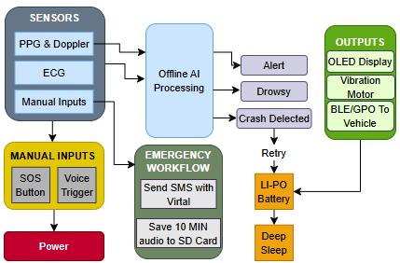
Methodology – AI Model & Alert Mechanism
1. AI Model (1D-CNN)
  Input: Processed sensor data
  Architecture:
    3 Convolution layers
    2 Dense layers
  Activation: ReLU
  Output: Softmax classification
2. Classification Output
  Alert (Normal)
  Drowsy
  Crash / Distress

Slide 11
Methodology – AI Model & Alert Mechanism
3. Decision Logic
  AI confirms abnormal condition
  Continuous abnormal state (>15 sec) → triggers alert
4. Emergency Alert System
  GSM module sends SMS
  Includes:
    GPS location
    Health parameters (HR, SpO₂)
  Retry mechanism (3 attempts)
  Backup contact alert
5. Additional Features
  SOS button / voice trigger
  10-minute audio recording stored

Slide 12
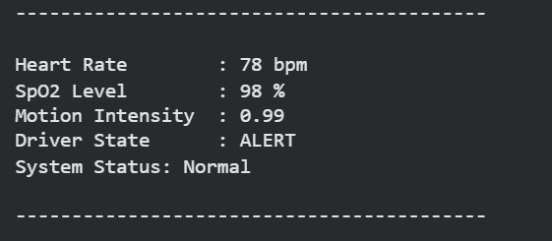
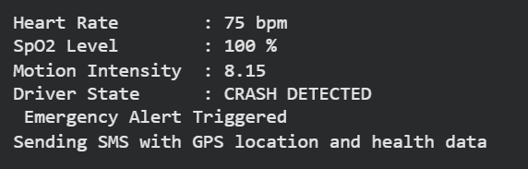
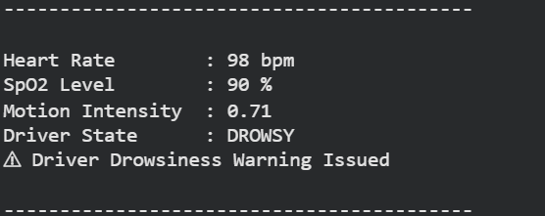
Experimental Results
Real-Time Outputs
Displays HR, SpO₂, Motion
AI classifies:
  Alert
  Drowsy
  Crash
System Response
Normal → System Stable
Drowsy → Warning Alert
Crash → Emergency SMS (GPS + Health Data)

Slide 13
Results & Discussion
Performance Metrics
Alert Detection Accuracy: 95.2%
Drowsiness Detection Accuracy: 93.4%
Crash Detection Accuracy: 96.7%
System Performance
Response Time: 3–5 seconds
Inference Time: < 200 ms
High Precision, Recall & F1-Score
Operational Efficiency
) Battery Life: ~12 hours active
Standby Time: ~24 hours
Fully offline operation (no internet required
Discussion
Multi-sensor fusion improves accuracy
Reliable performance in real-world conditions
Minor false positives due to sudden movements

Slide 14
Conclusion
Project Outcomes
Developed an AI-powered wearable smartwatch for real-time distress detection
Achieved high accuracy (93–96%) across alert, drowsy, and crash classes
Ensured real-time performance (inference < 200 ms; alerts in 3–5 sec)
System Capabilities
Multi-sensor fusion: ECG, HR, SpO₂, motion
On-device AI (TinyML) on ESP32-S3
Fully offline operation (no internet dependency)
Impact
Autonomous emergency response with GSM + GPS
Reduces response time in critical situations
Reliable in low-connectivity environments (tunnels, rural roads)
Future Scope
Personalized AI models per user
Larger, diverse datasets for improved robustness
Integration with emergency services / cloud APIs
Enhanced privacy & security (encryption)

Slide 15
References
P. Mahajan and A. Kaul, 'Enhanced cuffless blood pressure estimation using ECG and PPG signals: A hybrid approach with Windkessel, ARIMA, and LSTM', Turkish Journal of Electrical Engineering and Computer Sciences, vol. 33, no. 3, Art. no. 5, 2025, doi: 10.55730/1300-0632.4127.
A. Arjomand, F. Li, and J. Kang, 'TransfoRhythm: A Transformer Architecture Conductive to Blood Pressure Estimation via Solo PPG Signal Capturing', arXiv preprint arXiv:2404.15352, 2024.
S. Díaz-Santos and P. Caballero-Gil, 'Drowsiness detection in drivers with a smartwatch', arXiv preprint arXiv:2210.04066, 2022.
R. Florez, F. Palomino-Quispe, R. J. Coaquira-Castillo, J. C. Herrera-Levano, T. Paixão, and A. B. Alvarez, "A CNN-Based Approach for Driver Drowsiness Detection by Real-Time Eye State Identification," Applied Sciences, vol. 13, no. 13, p. 7849, 2023, doi: 10.3390/app13137849
E. Civik and U. Yuzgec, "Real-time driver fatigue detection system with deep learning on a low-cost embedded system," Microprocessors and Microsystems, vol. 99, p. 104851, 2023, doi: 10.1016/j.micpro.2023.104851.
J.-K. Lain, C.-A. Wang, J.-H. Xu, and C.-W. Lee, "Development of an Improved Stacked U-Net Model for Cuffless Blood Pressure Estimation Based on PPG Signals," IEEE Open Journal of Engineering in Medicine and Biology, vol. 6, pp. 584–590, 2025, doi: 10.1109/OJEMB.2025.3624566
S. A. Noh, H. S. Kim, S. H. Kang, C. H. Yoon, T. J. Youn, and I. H. Chae, "History and evolution of blood pressure measurement," Clinical Hypertension, vol. 30, no. 1, p. 9, Apr. 2024, doi: 10.1186/s40885-024-00268-7.

